Slide 1
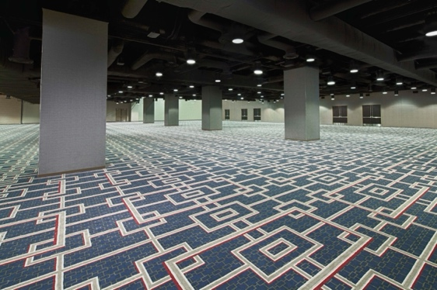
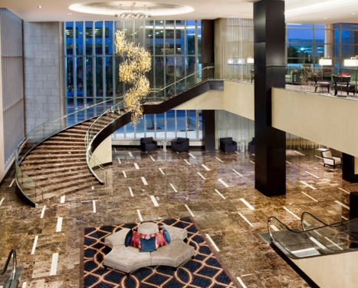
NEW ORLEANS HYATT REGENCY Exhibit Hall Floor Plan Elite Hall 1 & 2

Slide 2
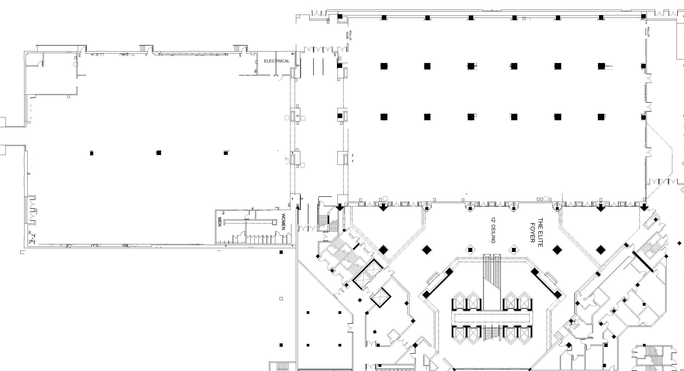
Exhibit Floor Plan
Elite Hall A
10’ceiling
Elite Hall B
15’4”ceiling
MAIN EXHIBIT HALL ENTRANCE & EXIT
NO ENTRANCE OR EXIT

Slide 3
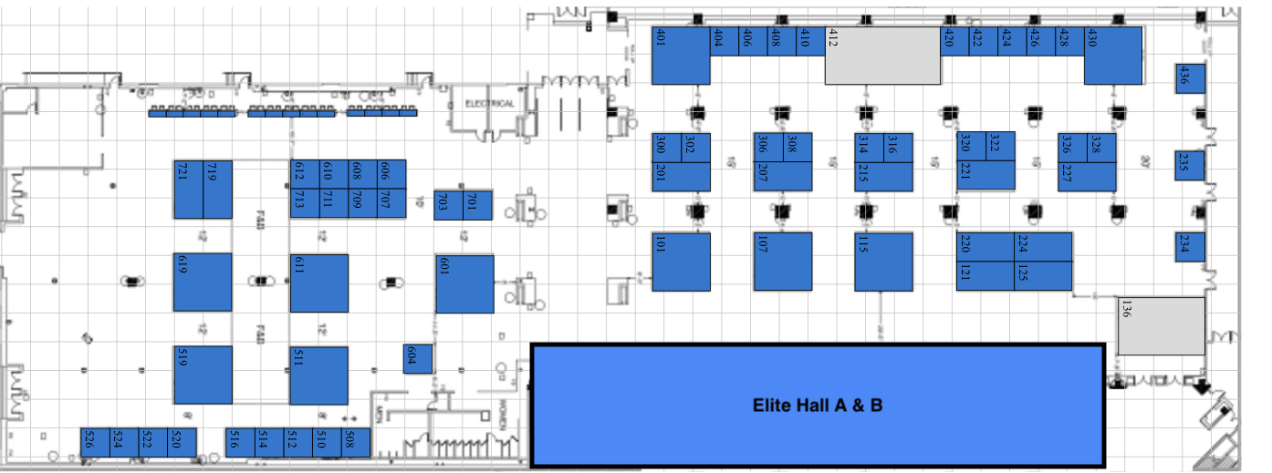
Exhibit Hall with Booth Number

Slide 4
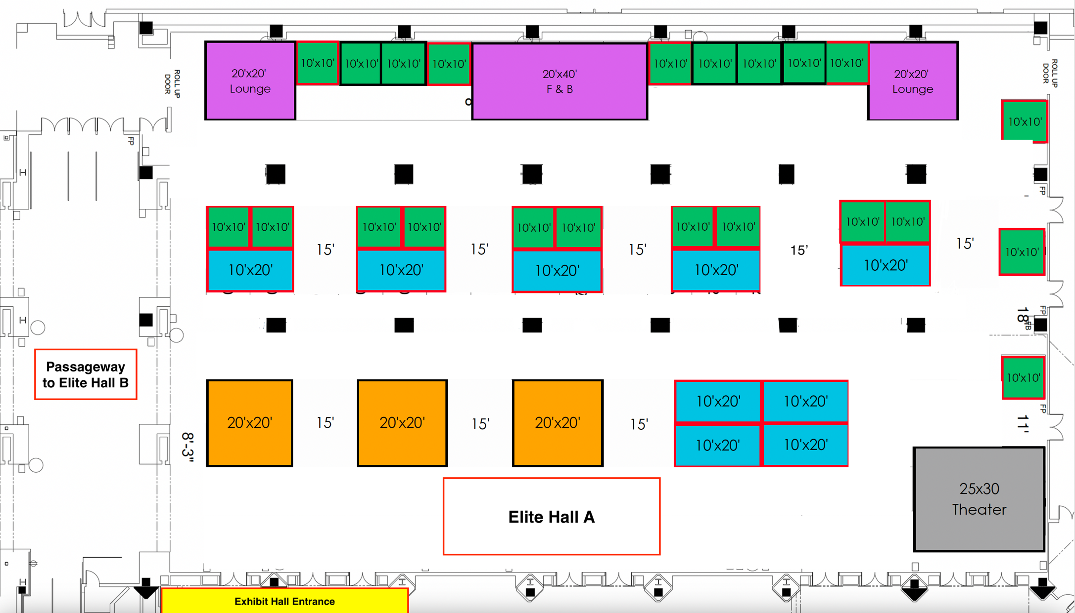
Exhibit Hall A

Slide 5
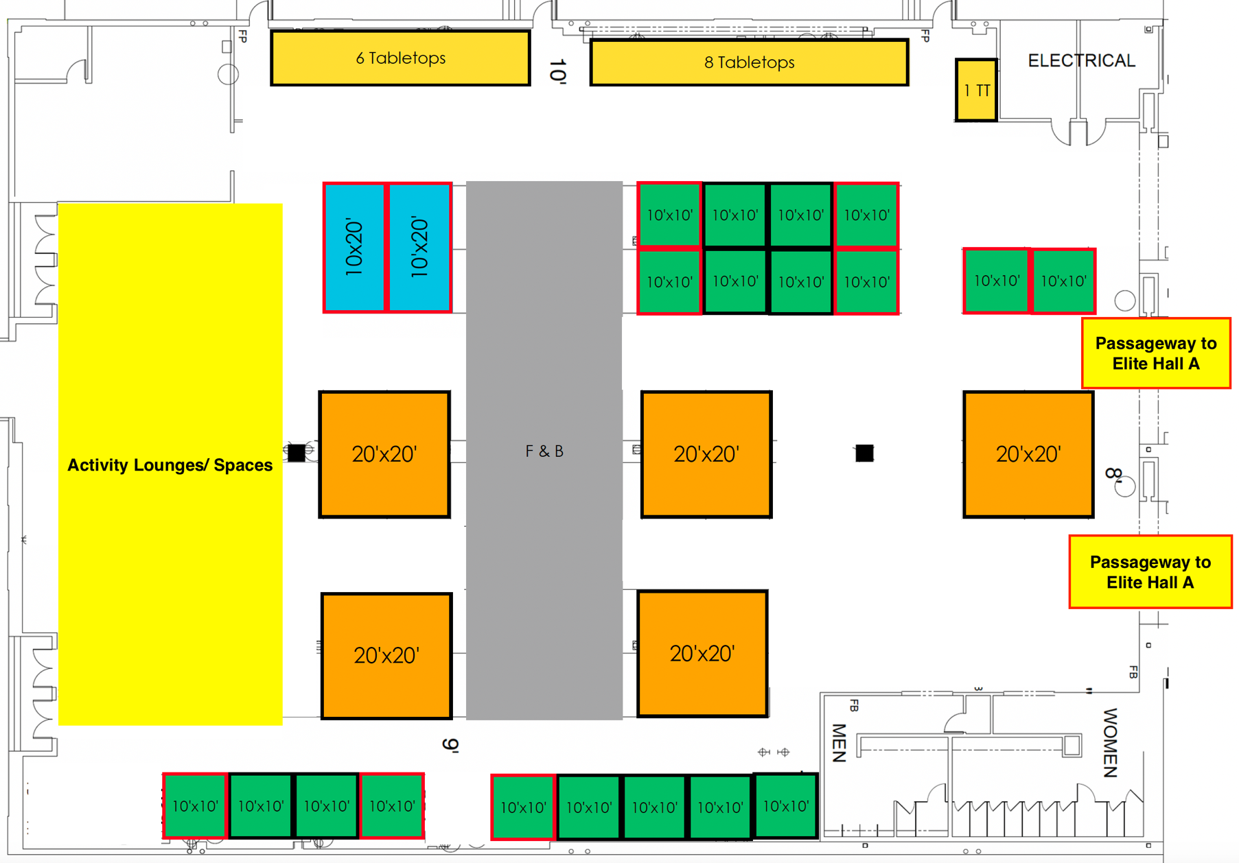
Exhibit Hall B

Slide 6
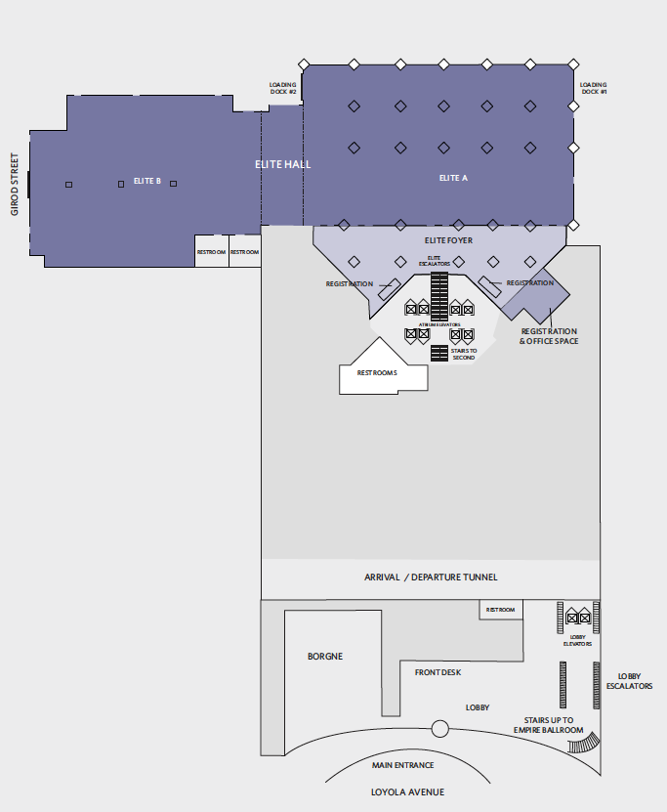
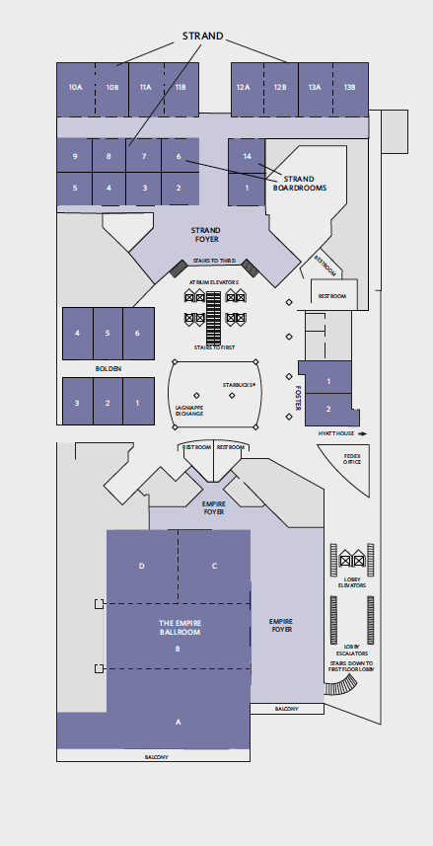
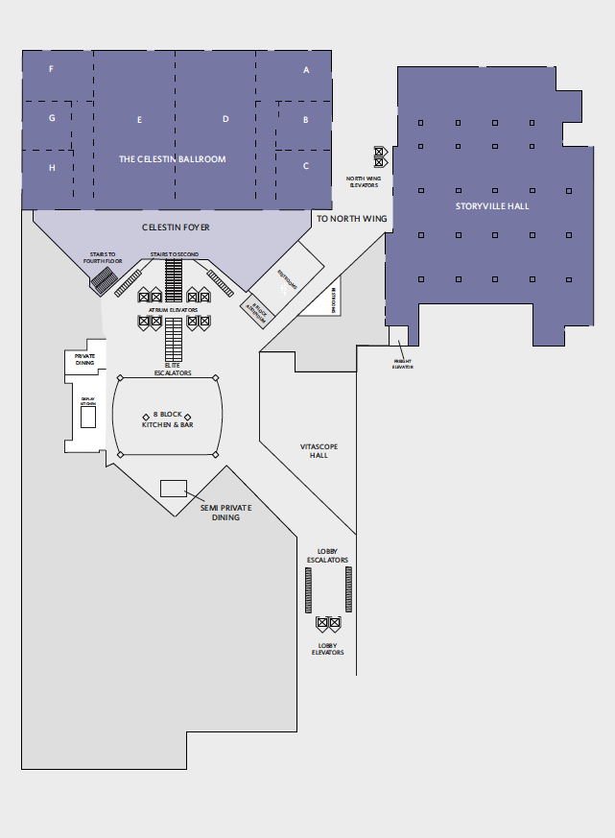
Hyatt Floor Plan
Level 1: Exhibit Hall and Receptions
^{Level 2: MAPS Registration,}
^{General Session, and Workshops}
^{Level 3: Didactic Sessions}

Slide 7
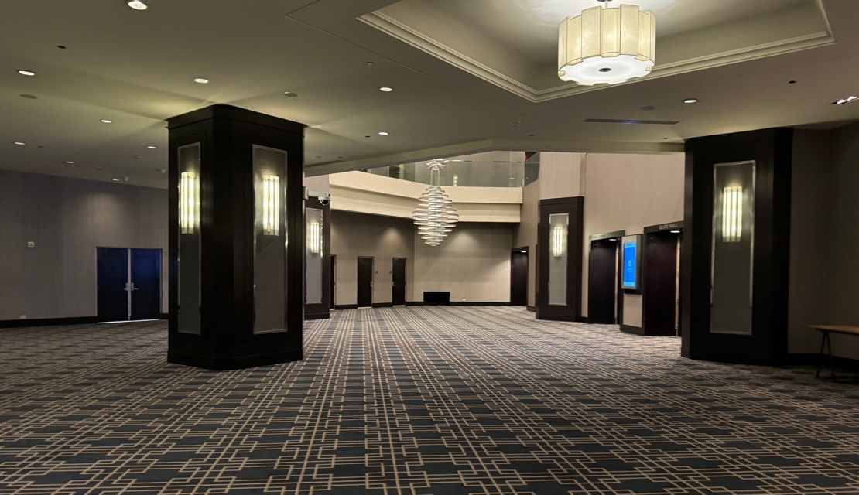
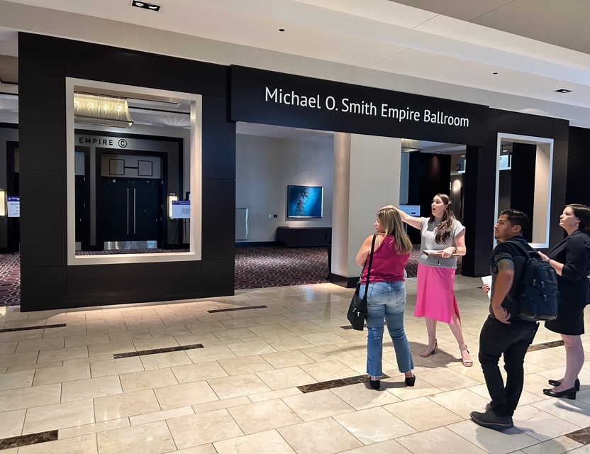
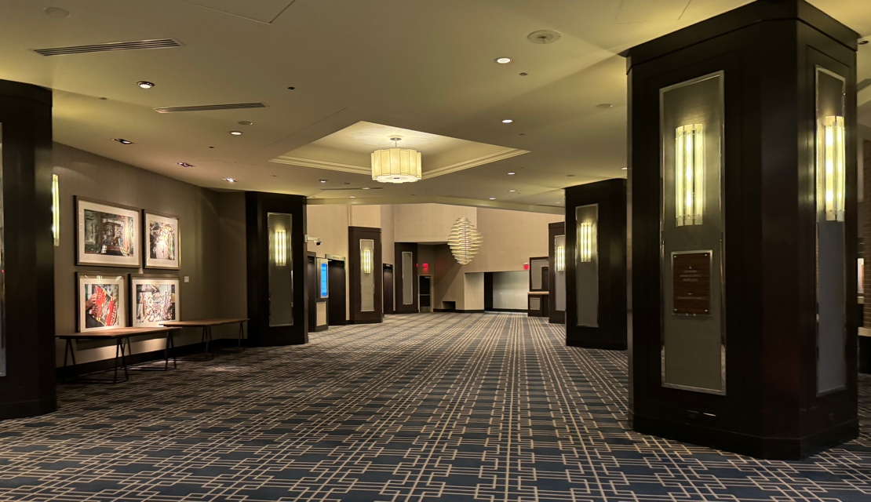
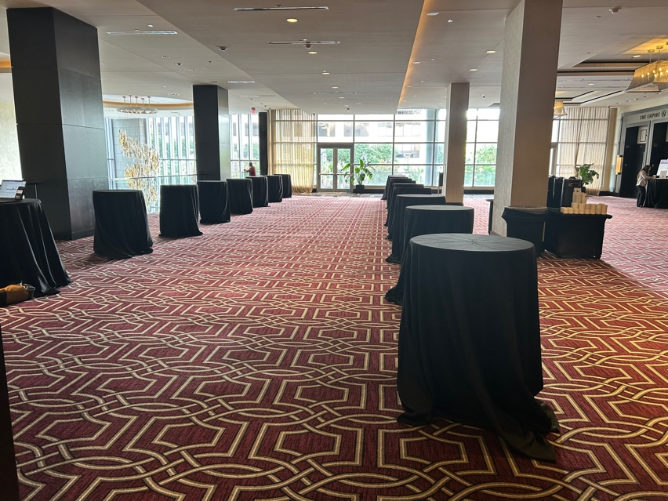
Various Event Space
FLOOR OVERVIEW
^{Level 1}
^{Exhibit Hall}
^{Receptions}
^{Level 2}
^{MAPS Registration}
^{General Session}
^{Workshops}
^{Level 3}
^{Didactic Sessions}
Left side: Pre-function Area
Registration Area
Right side: Pre-function Area
Left of Registration Area

Slide 8
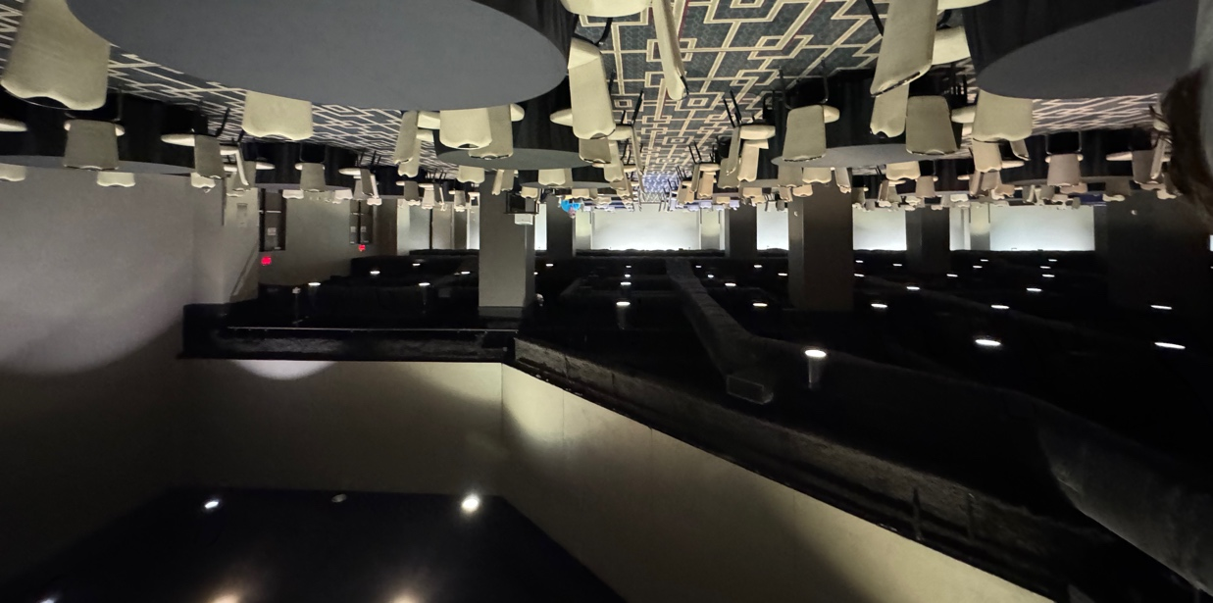
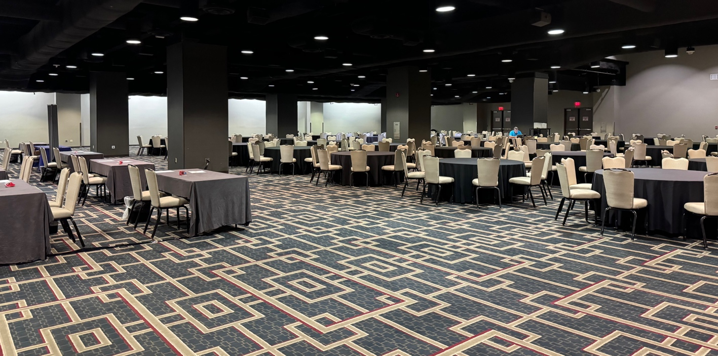
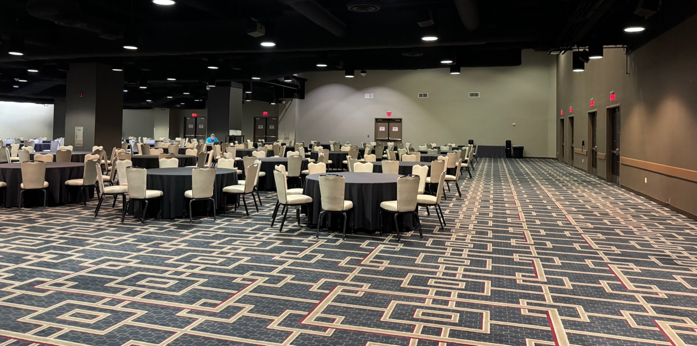
Exhibit Hall A
View from theater to 20x20 lounge
View from exhibit 115 to right side 20x20 lounge
View from exhibit 101 to theater

Slide 9
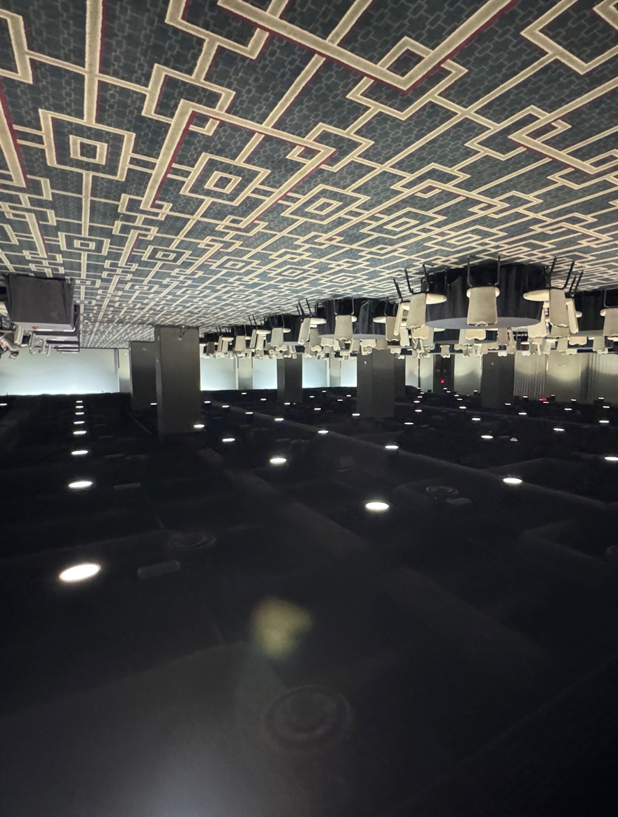
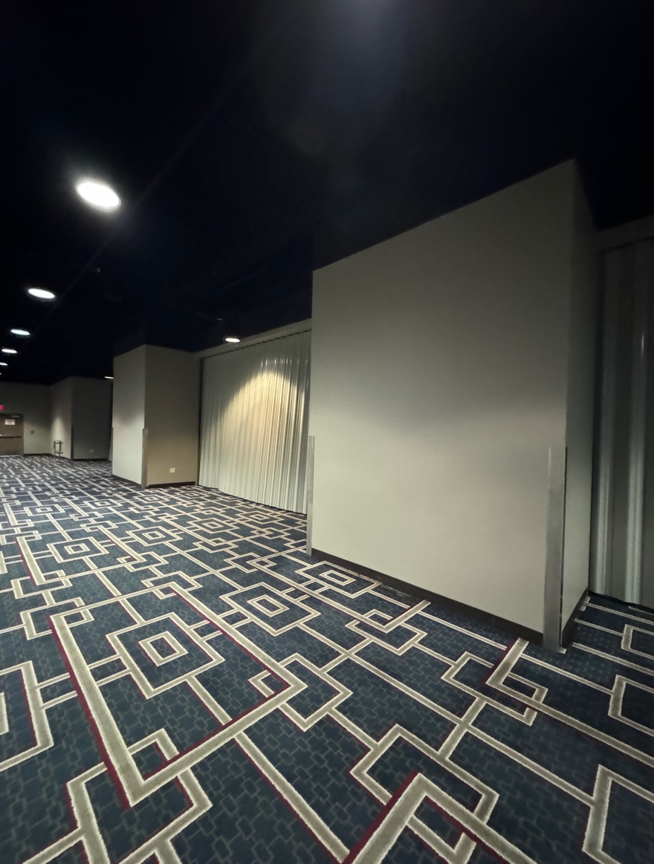
Exhibit Hall A
* Please note that the connecting doors will always be open connecting both Exhibit Halls.
Facing from exhibit 107 to
passageway into Elite Hall B
Entrance into Elite Hall B from the
passageway space

Slide 10
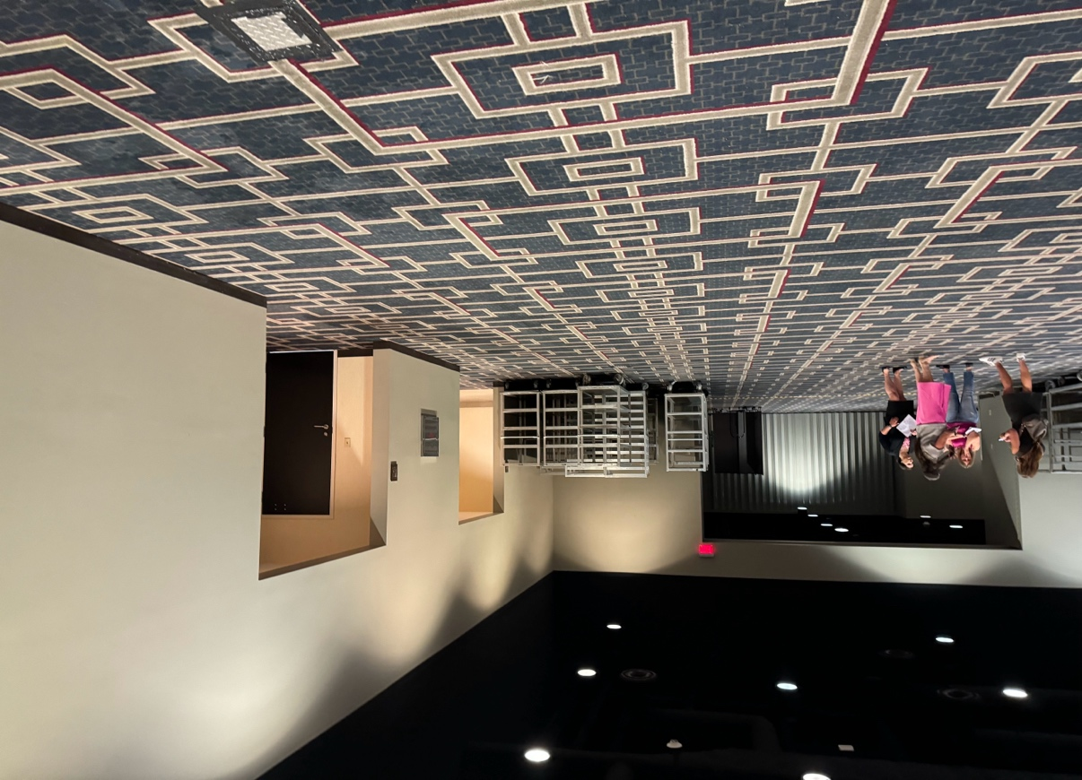
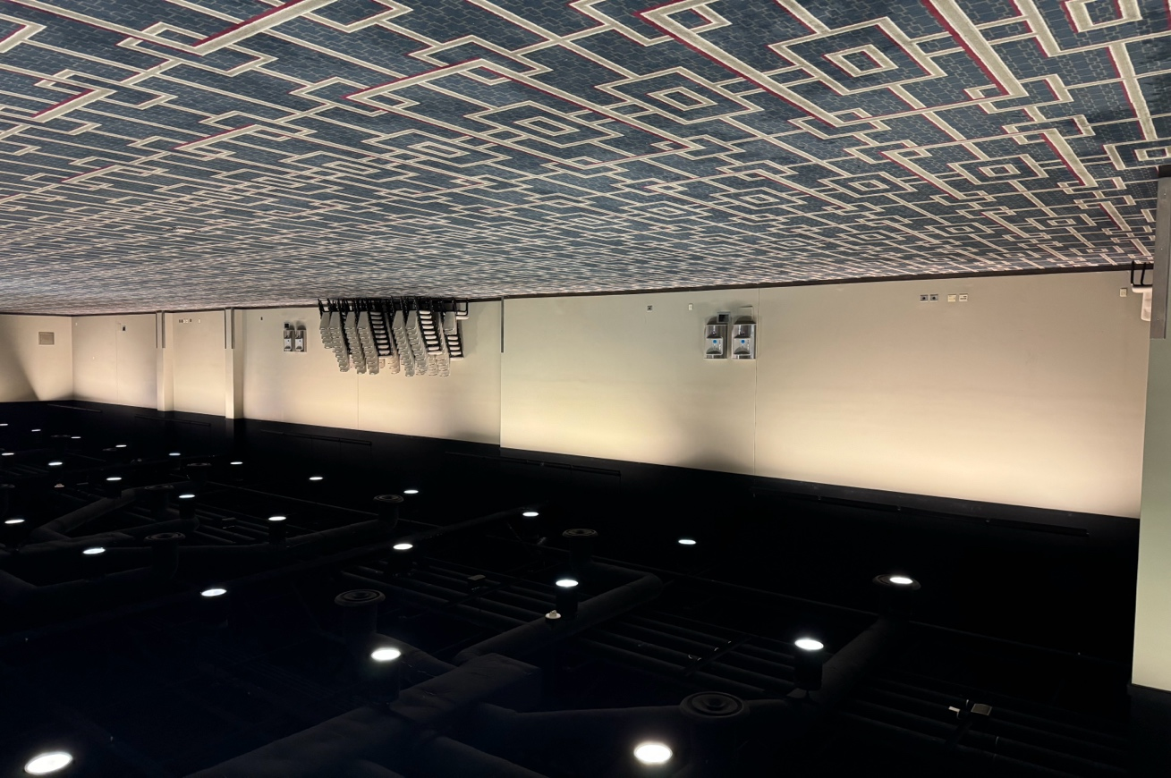
Exhibit Hall B
View from exhibit 511 to passageway into Elite Hall A
View of exhibit 508- 526

Slide 11
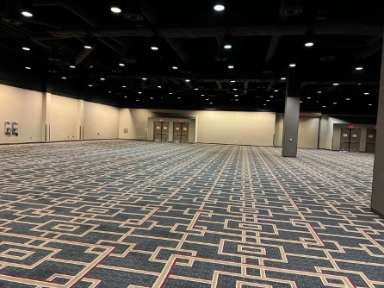
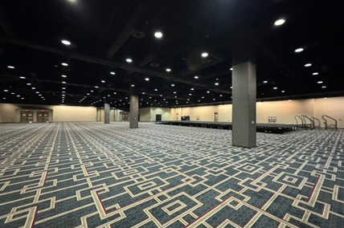
Exhibit Hall B
View from exhibit 601 to the left side view of Elite Hall B
View from exhibit 601 to the
right side view of Elite Hall B

