Slide 1
Strategic Integrated Evidence Generation Planning
Tips and Templates

Slide 2
Acknowledgements
The Medical Affairs Professional Society (MAPS) would like to thank the following contributors to Strategic Integrated Evidence Generation Planning Guidance Document:
Phil Wakefield, Chief Advisory Services Officer, Inizio Medical
Rachel Hatfield, Managing Partner, MEDiSTRAVA Consulting
Ann Hartry, AVP, Value, Evidence & Outcomes, Eli Lilly and Company
Damian Largier, Global Medical Affairs Lead, Migraine, Pfizer
Esther Liu, Senior Director, Integrated Evidence Generation, Eli Lilly and Company
Bhavik Pandya, Global Director – HEOR Oncology, Medical Affairs, Astellas
Cerise James, Principal, Medical Affairs, Tilghman James Group LLC
And with appreciation for the ongoing support from the Evidence Generation FAWG
Those named above contributed to Strategic Integrated Evidence Generation Planning Guidance Document in their personal capacity. The views expressed and guidance provided in this document and associated presentation are their own and do not necessarily represent the views of their named employers.

Slide 3
Rationale and purpose
This resource is intended to provide Medical Affairs teams with key tips and resources to support integrated evidence generation plan development, as well as reinforce the potential value planning can bring
The recommendations provided should be tailored to the individual organization, product, and treatment landscape
The views and information provided do not reflect the position or views of any one individual or company
Medical Affairs Professional Society | 2023

Slide 4
Integrated Evidence Planning: Key principles

Slide 5
The importance of evidence to multiple stakeholders
Generation of meaningful evidence is a critical requirement from all stakeholders
Patients
Understanding how treatments can impact quality of life as part of shared decision-making
Policymakers
Better understanding of patient’s unmet need can help with policy decision-making
Payers
Varying regional and local requirements need to be considered in order to support successful reimbursement and access
Industry
Strategic evidence planning needed to support differentiated value propositions throughout the product lifecycle
HCPs
Increasing variety of treatment options is furthering the need for evidence to support treatment decision-making in order to optimize patient outcomes.
Regulators
The rise of the expedited approval process, fast track and priority reviews is requiring further consideration of evidence beyond RCT

Slide 6
Medical affairs is central to strategic evidence generation
Identification of need, generation and communication of evidence is often disjointed with siloed departments creating and pursuing their own evidence plans
Cross-functional evidence requirements are often similar, with common gaps and questions that need to be addressed through evidence generation; however, evidence plans frequently remain uncoordinated between departments
Medical Affairs is ideally positioned to be the champion of coordinated, holistic evidence generation planning
Medical Affairs Professional Society | 2023

Slide 7
What is an Integrated Evidence Plan?
The IEP tracks evidence gaps and associated evidence generation plans including data sources, endpoints and timings together with plans for evidence dissemination. Critically, the IEP creates a commonality of approach across the various cross-functional departments of an organization
The IEP provides a comprehensive view of all relevant evidence and external research that supports common evidence objectives and/or drives strategic decision making supporting the development, launch, and continued support of an asset
The IEP is an internal document that prioritizes evidence generation requirements in an efficient manner across functions, countries and the product lifecycle. It is also a ‘living document’ that will be regularly updated in response to external market forces and internal demands

Slide 8
Example cross-functional evidence generation activities
Term | Definition
Evidence generation¹ | Evidence generation is multidimensional, including data source, study design, and degree of pragmatism
Real-world data² | Data relating to patient health status and/or the delivery of health care routinely collected including: Electronic health records; claims and billing activities Product and disease registries Patient-generated data Data gathered from other sources that can inform on health status, such as mobile devices
Real-world evidence² | Clinical evidence regarding the use and potential benefits/risks of a product derived from RWD analysis Typically generated from observational research but can also derive from other study designs such as RCT, pragmatic trials, or large simple trials
Evidence generation activities
Preclinical data Translational data and signal studies Registration trials Company-sponsored life-cycle management trials Post-hoc analyses and mining of trial data Inform strategy for investigator-sponsored studies Treatment pathways, outcomes, and resource data Clinical and economic burden Line of therapy analyses Meta-analyses Appropriate use in real life conditions Indirect treatment comparisons HEOR studies Registry mining Augment and update publications plan Develop stakeholder communication narratives
Can form IEP
RCT, randomized clinical trials.
1. Jarow JP, et al. JAMA. 2017;318(8):703-704; 2. https://www.fda.gov/science-research/science-and-research-special-topics/real-world-evidence.

Slide 9
Why is an IEP beneficial
Efficient Evidence Generation
Tracks all existing and planned evidence generation and allows identification of commonalities across multiple functions to ensure both an efficient and effective means of generating evidence to strategically meet internal/external stakeholder needs
Uniform Approach
By following a formalized approach to its construction, the IEP provides a consistent framework across all functions
Transparency
Increases visibility and transparency for cross-functional evidence generation needs and plans
Prioritization of Evidence Generation
Allows for prioritization of evidence generation needs and supports decision-making with regard to resource allocation enabling elimination of redundant and low impact research – ensures all gaps are identified and prioritized
Product Positioning
Ultimately the IEP can help support the product positioning in order to best ensure realization of the brand vision

Slide 10
Key principles for activating an IEP
Collaborative
Strategic
Insight-led
Geographical representation
Living document
Although medical affairs will drive its creation, cross-functional representation (e.g., clinical development, market access, commercial) is essential to maximize value
Evidence needs and plans should be aligned with the priorities of the product/franchise strategy
Be based on a deep understanding of key stakeholder evidence needs
Global, regional and local needs should be reflected, where possible
The plan should be regularly revisited to ensure it remains relevant
External events, e.g. competitor data release should also prompt review
Impact of activities should be tracked to determine if an alternative approach is required

Slide 11
When to initiate the IEP
Prior to strategic business planning each year
Ideally during Proof Of Concept at Phase I/II where key insights can help shape the development of subsequent studies
Some companies are producing IEPs as early as asset discovery/ pre-clinical
Medical Affairs Professional Society | 2023

Slide 12
How to approach planning for an IEP
Set up a cross-functional evidence generation core team
Collate and review relevant documents from all internal stakeholders including:
Product strategy, including vision and strategic imperatives and a TPP
Landscape analyses
Scientific platform and publications plan
Any current patient journey, gap analyses or evidence generation plans
Competitor intelligence
Run internal/external stakeholder interviews to understand challenges/opportunities and allow open discussion around key research questions

Slide 13
Integrated Evidence Planning:
Processes and templates

Slide 14
Process Overview
1
2
3
4
5
PREPARE
Prepare strategic priorities for evidence needs
DEFINE
Identify and prioritize evidence gaps
DESIGN
Design evidence generation programs to support identified gaps
EXECUTE
Evidence generation & dissemination
REVIEW
Ensure regular check-ins to ratify IEP

Slide 15
Process Flow
Prepare
Define
Design
Execute
Review
Step 1: Prepare
Medical Affairs
Prepare strategic priorities for evidence needs
Set up cross-functional IEP core team led by Medical Affairs
Collate relevant stimuli
Conduct internal/ external interviews
Align on strategic priorities for evidence generation
Commercial
Clinical Development
Regulatory
HEOR / Market Access

Slide 16
Process Flow
Prepare
Define
Design
Execute
Review
Step 2: Define
Identify and prioritize evidence gaps
Workshop 1: Interactive, cross-functional discussions, centered on aligning evidence gaps with stakeholder priorities and impact on patient outcomes

Slide 17
Workshop 1: Sample template for completion
Prepare
Define
Design
Execute
Review
Strategic imperative | Evidence gap | Risk if not filled | Target stakeholder | Priority (H, M, L)* | Geographical scope (region/country-based)
*prioritization exercise on following slide

Slide 18
Workshop 1: Gap prioritization
Prepare
Define
Design
Execute
Review
High
Plan
Act
Grid can be used by working groups as a template to organize gaps
IMPACT
Hold
Prioritize
Low
High
FEASIBILITY*
*resource, time, budget, risk to be considered

Slide 19
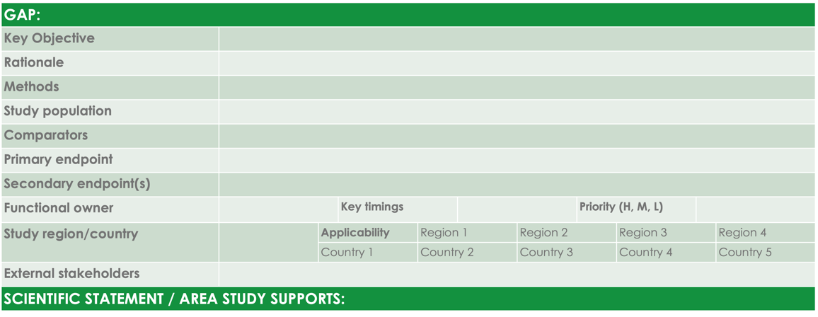
Process Flow
Prepare
Define
Design
Execute
Review
Step 3: Design
Design evidence generation plan to support identified gaps
Workshop 2: gap fill exercise for priority gaps – high level planning (including topline budget/ resource needs)
Ratification with key internal/ external stakeholders to prioritize evidence needs
Ensure gaps are not being filled as part of any current functional plans
Align with appropriate functions for evidence generation activities; investigator-initiated studies, internal study design etc.
Complete the IEP template to track progress and ensure all gaps are prioritized/filled as required

Slide 20
Workshop 2: Sample template
Prepare
Define
Design
Execute
Review
GAP:
Key Objective
Rationale
Methods
Study population
Comparators
Primary endpoint
Secondary endpoint(s)
Functional owner |  |  | Key timings |  |  |  | Priority (H, M, L)
Study region/country |  | Applicability |  | Region 1 |  | Region 2 |  | Region 3 |  | Region 4
 |  | Country 1 |  | Country 2 |  | Country 3 |  | Country 4 |  | Country 5
External stakeholders
SCIENTIFIC STATEMENT / AREA STUDY SUPPORTS:

Slide 21
IEP Sample Template
Prepare
Define
Design
Execute
Review
IEGP
Strategic imperative / Strategic link | Gap description | Anticipated data use | Impact of gap not being closed | Target stake-holder | Priority | Regional applicability (insert countries as needed) |  |  |  | Key objective / Study description | Key timings (data availability etc.) | Owner (function) | Budget
 |  |  |  |  |  | US | EU | EU | APAC

Slide 22
Process Flow
Prepare
Define
Design
Execute
Review
Step 5: Execute
Evidence generation & dissemination
Share plan with functions & affiliates for execution
Expand to communication planning
Medical Affairs Professional Society | 2023

Slide 23
Process Flow
Prepare
Define
Design
Execute
Review
Step 6: Review
Ensure regular check-ins to ratify IEP
Set the cycle for regular review and update by IEP core team (e.g., every 6 months unless key external event)
Medical Affairs Professional Society | 2023

