Slide 2
MAPS Medical Affairs Strategic Planning Guide
Guidance Document
Please view in PowerPoint show mode, to enable interactivity
Overview

Slide 3
Acknowledgments
The Medical Affairs Professional Society (MAPS) would like to thank the following contributors to the MAPS Medical Affairs Strategic Planning Guide and Template:
    Charlotte Kremer, MD, MBA, EVP, and Head of Medical Affairs,
    Astellas Pharma, Northbrook, IL
    Joseph Kohles, PhD, Chief Medical Officer, Envision Pharma Group, Philadelphia, PA
    Peter Piliero, MD, VP, US Medical Affairs, Merck & Co. Upper Gwynedd, PA
    Therese McCall, PhD, MBA, Vice President, Medical Affairs, Assertio Therapeutics, Lake Forest, IL
    Leah Williams, MS, Medical Strategy Lead, Envision Pharma Group, Philadelphia, PA
Those named above contributed to MAPS Medical Affairs Strategic Planning Guide and Template in their personal capacity. The views expressed and guidance provided in the guide and template are their own and do not necessarily represent the views of their named employers.
Overview

Slide 4
Please Note:
This guide has been developed with senior Medical Affairs professionals to provide guidance and recommendations to selected components that comprise the strategic Medical Affairs planning for a product – including the situational analysis, medical strategy, and tactical/operational planning.
This guide and complementary template provide a foundation for consideration during your annual planning cycle.
Neither the template nor the information in the guide need to be used in totality as requirements by company may vary
Please refer to the MAPS Medical Affairs Strategic Plan Template created for use in your planning efforts
Overview

Slide 5
Medical Affairs Strategic Plan Guide
Key Sections
GUIDE
Tactical and Operational Plan. Slides 39-46
Overview. Slides 6-8
Providing an introduction to the MAPS Medical Affairs Strategic Planning Guide
Translating the strategy into tactics and activities supported by the medical affairs functional teams
Situational Analysis. Slides 9-27
Medical Summary. Slides 47-49
Defining the current situation in terms of the science, product profile, therapeutic landscape, and key insights
Providing a high-level summary of the strategy, tactical plan, and budget and timing
Medical Strategy. Slides 28-38
Next Steps. Slide 50
Defining the vision, strategic medical objectives, and drivers for the product
Providing a high-level summary of the strategy, tactical plan, budget and timing
TEMPLATE
MAPS Medical Affairs Strategic Plan Template. Slides 51-93
Providing full medical affairs strategic plan template to adapt for planning efforts, including situational analysis, medical strategy, tactical and operational plan, and medical summary
Overview

Slide 6
Medical Affairs Strategic Planning Overview: Key Questions
Situational Analysis
Medical Strategy
Tactical and Operational Plan
Medical Plan Summary
Where are
we now?
What is our current situation?
Where do we want to be versus current gaps?
What do we need to do to get there?
How do we
get there?
What are the actions, tactics
or initiatives that will achieve the strategic goals?
What do we need to execute the plan?
Overview

Slide 7
Medical Affairs Strategic Planning Overview: Content
Situational Analysis
Medical Strategy
Tactical and Operational Plan
Medical Plan Summary
The Disease
Therapeutic Landscape
Product Profile
Stakeholder Insights
Gap Analysis
Vision
Medical Objectives
Strategic Medical Drivers
Medical Affairs
Functional Activities
Medical Plan Strategic Overview
Budgets
Timelines
Resources
Overview

Slide 8
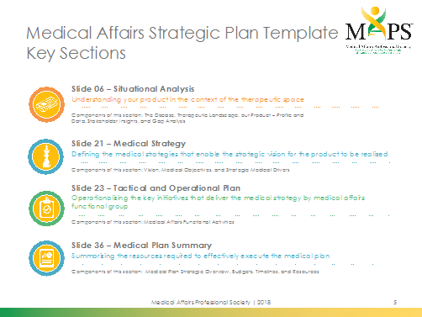
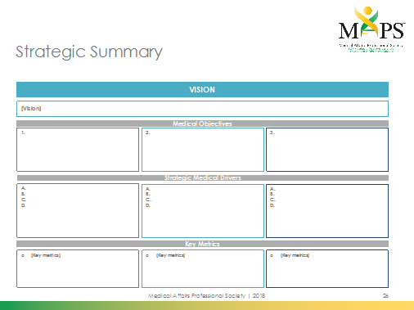
Medical Affairs Strategic Plan Template
The template has been provided as a foundation for planning efforts
  Requirements for MA strategic planning by company may vary
  All slides may not be used
Sections of the template are aligned to the guidance document and can be found immediately following the guidance document in this file
PLEASE NOTE: Only key components of the template are covered in more detail in this guidance document
Overview

Slide 9
Situational Analysis
The Disease
Therapeutic Landscape
Product Profile
Stakeholder Insights
Gap Analysis
Situational Analysis

Slide 10
Situational Analysis
This section of the slide deck provides an overview of key aspects to consider as part of the situational analysis
Please refer to MAPS Medical Affairs Strategic Plan Template for the slides that can be used as part of this section
Situational Analysis

Slide 11
Situational Analysis:
Understanding Where We Are Now
Strategy is never developed in a vacuum, so it is important to understand a product in the context of the therapeutic space and available treatment options
S
W
Strategy
O
T
Current Situation
Desired Situation
Situational Analysis

Slide 12
Situational Analysis: External Analyses
External analyses look at the current environment – mostly independent from the product or organization
External Analyses
Disease Landscape
Competitor Analysis
Audience Analysis
Regulatory Analysis
Standard of Care, unmet medical needs, cost/value, patient journey, diagnostic criteria, and congresses
Literature,
clinical data,
competitive intelligence, launches, label updates, and analysts reports
Providers,
payers, patients, and others
Approvals, approval pathways,
pricing, and criteria for reimbursement
Situational Analysis

Slide 13
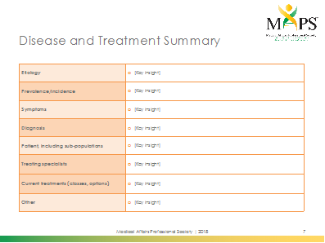
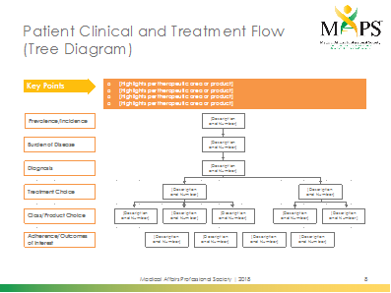
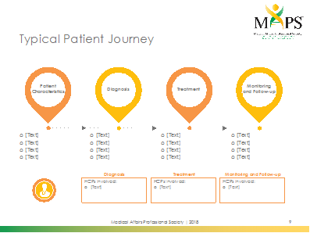
Situational Analysis: External Analyses
Disease Landscape
Standard of care, unmet medical needs, cost/value, patient journey, diagnostic criteria, and congresses
Medical Affairs Strategic Plan
Situational Analysis

Slide 14
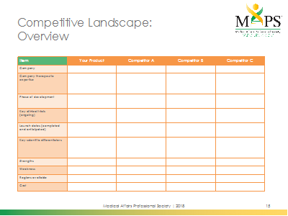
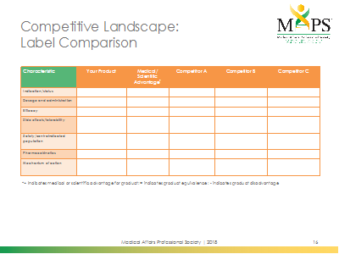
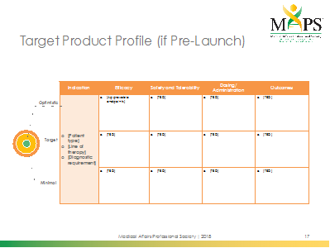
Situational Analysis: External Analyses
Competitor Analysis
Literature, clinical data, competitive intelligence, launches, label updates, and analysts reports
Medical Affairs Strategic Plan
Situational Analysis

Slide 15
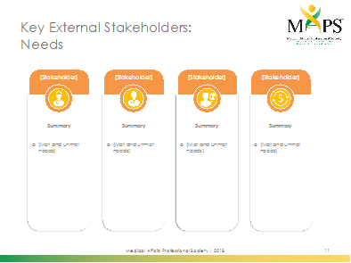

Situational Analysis: External Analyses
Audience Analysis
Providers, payers, patients, and others
Medical Affairs Strategic Plan
Situational Analysis

Slide 16
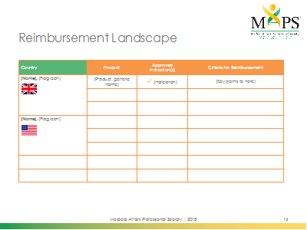
Situational Analysis: External Analyses
Regulatory Analysis
Approvals, approval pathways,
pricing, and criteria for reimbursement
Medical Affairs Strategic Plan
Situational Analysis

Slide 17
Situational Analysis: Internal Analyses
Internal analyses look at your product, organization, and other internal factors
Internal Analyses
Clinical and Regulatory Analysis
External Expert/
Field Insights
Gap Identification
Internal gaps in evidence generation, interpretation, communication and/or education
New and upcoming data, clinical development, and regulatory milestones
Advisory boards, stakeholder engagements,
field insights (MSLs), and additional research
Situational Analysis

Slide 18
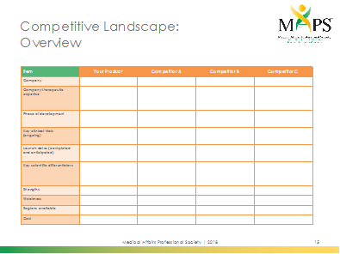
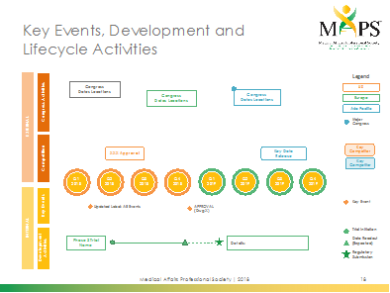
Situational Analysis: Internal Analyses
Clinical and Regulatory Analysis
New and upcoming data, clinical development,
and regulatory milestones
Medical Affairs Strategic Plan
Situational Analysis

Slide 19
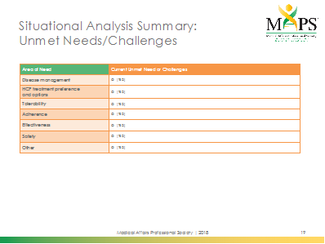
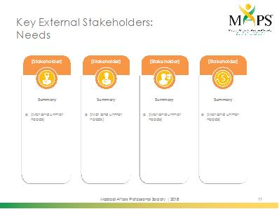

Situational Analysis: Internal Analyses
External Expert/Field Insights
Advisory boards, stakeholder engagements,
field insights (MSLs), and additional research
Medical Affairs Strategic Plan
Situational Analysis

Slide 20
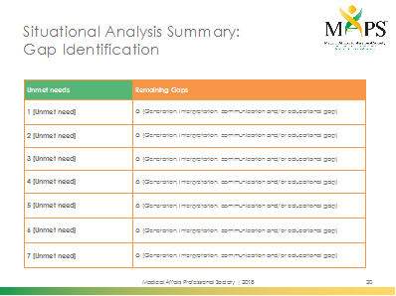
Situational Analysis: Internal Analyses
Gap Identification
Internal gaps in evidence generation, interpretation, communication and/or education
Medical Affairs Strategic Plan
Situational Analysis

Slide 21
Situational Analysis: Gap Analysis
A gap analysis identifies the potential gaps between the current and desired situation for the product and therapy area
  Aligned to the unmet needs by external stakeholder
Formally identify potential gaps to address with the medical strategy and tactical planning phases
Helps identify
  New research questions/ideas
  Product data or evidence needs
  Educational or communication needs by stakeholder
  Other items to be addressed in tactical planning
S
W
Identification Gap
O
T
Current Situation
Desired Situation
Situational Analysis

Slide 22
Situational Analysis: Medical SWOT
A Medical SWOT is a collaborative and structured approach to understanding where your product stands in the current environment and disease state –identifying both internal and external factors
It is a combination of:
S
W
O
T
Internal
External
Strengths and Weaknesses
Opportunities and Threats
Situational Analysis

Slide 23
Medical SWOT: Key Questions in the Current Disease Space
INTERNAL: Product or Company Specific
Strengths
What does your product or company offer that provides a competitive advantage?
Weaknesses
What does company or product offer or not offer
that may be considered
a disadvantage?
S
W
EXTERNAL: Environment Specific
Opportunities
What environmental factors provide opportunities for
your product?
Threats
What environmental factors pose challenges for
your product?
O
T
Situational Analysis

Slide 24
Medical SWOT: Thinking Internally
INTERNAL: Product or Company Specific
Strengths
What does your product or company offer that provides a competitive advantage?
Weaknesses
What does company or product offer or not offer
that may be considered
a disadvantage?
S
W
EXAMPLES
Positive attributes or factors that are within your control
Preclinical and clinical data
Unique features of product
Beneficial aspects or capabilities of your company or MA organization
Important information
Differentiators or advantages over
other products
Negative attributes or factors that are within your control
Key concerns or considerations
Factors the product or company may lack
Clinical issues of product
Concerns about data/study design
Improvements needed to processes
Perceived weaknesses relative to
other products
Situational Analysis

Slide 25
Medical SWOT: Thinking Externally
EXAMPLES
Factors outside of your direct control that help your product tap into the potential of the environment in the therapeutic space and in turn, provide value to patients
Beneficial trends or potential changes in the environment, competition, industry/government, and technology
Unmet medical or clinical needs
Gaps or disadvantages in the competitor or competitor’s data
Factors outside of your control that reduce the potential for your product in the environment in the therapeutic space and in turn, provide value
to patients
Risky trends or negative changes in the environment, competition, industry/government, and technology
Obstacles that need to be overcome
Perceived or real advantages of competitors
EXTERNAL: Environment Specific
Opportunities
What environmental factors provide opportunities for
your product?
Weaknesses
What environmental factors pose challenges for
your product?
O
T
Situational Analysis

Slide 26
Medical SWOT: Next Steps
Output will help guide medical and scientific strategy by answering key questions
S
How do we capitalize on or use each strength?
O
How do we take advantage
of each opportunity?
W
How do we overcome or stop each weakness?
T
How do we counter or defend against each threat?
Helps to define clear and poignant strategic actions for your medical plans
Situational Analysis

Slide 27
Key Considerations for the
Situational Analysis
Ensure collaboration from key medical affairs and cross-functional internal stakeholders (research and development, commercial, market research, etc.)
to guarantee up-to-date information for your analyses
Plan for internal workshops and/or brainstorm sessions with the integrated MA teams to finalize the situational analysis and help identify medical/scientific product challenges, opportunities, and gaps
Situational Analysis

Slide 28
Medical Strategy
Vision
Medical Objectives
Strategic Medical Drivers
Medical Strategy

Slide 29
Medical Strategy
This section of the slide deck provides an overview of key aspects to consider as part of the situational analysis
Please refer to MAPS Medical Affairs Strategic Plan Template for the slides that can be used as part of this section
Medical Strategy

Slide 30
Understanding Where We Want to be:
Strategic Terminology Lexicon
Vision for a product is a broad overarching goal typically used
across functions
  EXAMPLE: Establish product X as the backbone of therapy for every patient with disease X
Medical objectives facilitate moving from the current situation to the desired goals
  EXAMPLE: Communicate the value to product X to key audiences
Vision
Medical objectives
Strategic medical
drivers
Example only
Like the medical objectives, the strategic medical drivers are key objectives, but are more granular and support the associated medical objective – they help facilitate translation of strategy into key tactics
  EXAMPLE: Educate urologists on the outcomes measures of clinical trial X for product X
Medical Strategy

Slide 31
Setting a Vision
A vision is a broad statement of how the company wants its customers to think about the product
Often broad and lofty!
Typically, the vision is set by senior leadership to be used for all cross-functional support for the brand
While the vision clearly outlines the end goal, it provides no information on how to get there
For example:
  Establish product X as the preferred treatment option for every patient with disease X
2018
Medical Strategy

Slide 32
Determining Your Medical Objectives
Medical objectives clearly define outcomes essential to achieve vision that can be achieved by the MA functional teams
In practical terms, medical objectives define what initiatives
to focus on, and to whom they should be directed
Typically, 3-4 strategic objectives per vision
Tend to be relatively broad in nature but relate to evidence generation, interpretation or communication
S
W
Medical Objectives
O
T
Current Situation
Vision
Medical Strategy

Slide 33
Determining Your Medical Objectives (2)
For example:
  Detail how you are going to fill a data gap. What type of evidence will be generated, and when will it be available?
  Define how you are going to communicate new data, what audience, what story line, and when?
S
M
A
C
Use SMAC: Specific, Measurable, Achievable and Compatible
(with the overall strategy)
Medical Strategy

Slide 34
Medical Objectives:
Pre-Launch Example
Medical Objective | Pre-Launch Example
1 Disease Awareness | Communicate the dynamic and debilitating nature of the disease X to all HCP stakeholders
2 Diagnosis | Provide evidence and tools to support the appropriate early screening/diagnosis of previously undiagnosed patients (eg, family members)
3 Efficacy/Safety | Provide clinical data to support that product X is generally safe and effective to use in the XX patient population
4 Internal Launch Preparedness | Support the development of an internal training program on disease X to ensure all internal stakeholders have a better understanding of the disease
2018
Medical Strategy

Slide 35
Medical Objectives:
Post-Launch Example
Medical Objective | Post-Launch Example
1 Unmet Need | Provide evidence to characterize the clinical, economic, and patient- centered unmet needs for (rare disease) in the pre- and post-treatment environment
2 Expand Efficacy and Safety | Provide data to support that product X is safe and effective to use in other patient populations (non-label)
3 Treatment Optimization | Optimize biomarker strategy for tailored treatment with product X
4 Value/Effectiveness | Provide real-world evidence and decision support tools to payers, providers, and patients that support access and reimbursement, appropriate utilization, and adherence for early and long-term treatment
2018
Medical Strategy

Slide 36
Identifying Strategic Medical Drivers
Strategic Medical Drivers key objectives that help facilitate the translation of the strategy into tactics
Aligned with each medical objective, strategic medical drivers give a little more granularity to these broad objectives around the current scientific theme
Often better defines the audience or the desired outcome
Used as needed with the intent of aiding in the development and assignment of specific tactics, if the medical objective is specific and actionable enough drivers may not be needed
Medical Strategy

Slide 37
Strategic Medical Drivers:
Post-Launch Example
1 Unmet Need | Provide evidence to characterize the clinical, economic and patient-centered unmet needs in the pre- and post-treatment environment
Medical Objective
A
Support acquisition of new or retrospective clinical data on the natural history of disease X
B
Identify unmet needs in the current management practices of disease X
C
Determine the economic burden of disease X for payers and society
Strategic Medical Drivers
Medical Strategy

Slide 38
Medical Strategy
Define strategies that align with overall
product objectives
Consider the strategy and objectives of commercial, market access, and other cross-functional teams within your organization – but remain focused on the strategy that is best suited to MA teams
Ensure your medical strategy delivers on the needs of the patients, other stakeholders, and the organization
Medical Strategy

Slide 39
Tactical and Operational Plan
Medical Affairs Functional Activities
Tactical and Operational Plan

Slide 40
Tactical and Operational Plan
This section of the slide deck provides key considerations when you are developing your tactical or operational plan for your medical strategy
Please refer to MAPS Medical Affairs Strategic Plan Template
for the slides that can be used as part of this section
Tactical and Operational Plan

Slide 41
Tactical and Operational Delivery of the Strategy
Identify tactics that encompass all medical affairs functions
Align with medical strategy
  Activities must be linked to and deliver on the strategic medical objectives and drivers
Define ownership to MA team members for project definition, management, and accountability
Ensure to associate budgets and timelines with anticipated initiation and completion dates
Tactical and Operational Plan

Slide 42
Tactical and Operational Plan: Consider the MA Functional Groups
Think across all relevant work streams in MA
Strategic Direction
Medical Strategy
Evidence Generation
Evidence Interpretation
Evidence
Communications
MA Functional Work Streams
Clinical Trials/ Collaborations
Investigator Supported Studies
Health Outcomes Research (HEOR)
Other Data Generation
External Expert Engagement
(ie, Advisory boards, scientific advice)
Field Medical/External Stakeholder Engagement
Medical Communications (ie, Publications)
Medical Information
Medical
Education
Internal Training and Support
Tactical and Operational Plan

Slide 43
Tactical and Operational Plan:
Consider the Phase in Development
Earlier involvement in the life cycle to be ready at launch
P1/P2a
P2b
P3
Submission
Post-Approval
Medical Strategies
Gathering of External Insights
Timing of MA Involvement
Scientific Exchange and Medical Information
Data Generation
Publications
Launch
Tactical and Operational Plan

Slide 44
Tactical and Operational Plan: Consider the Key External Stakeholders
A tactical plan is focused on
strategy but should be aligned to
your stakeholder groups
  May be broad depending on the therapeutic area
Communication and education
  Expanding the knowledge base for
  your product and therapeutic area
  helps customers remain up-to-date
  and ensures the best patient care
Advocacy and knowledge exchange
  Advocates and advisors can ensure
  your data is put fully into context and provide guidance or answers to key questions
External experts
Allied health professionals
Hospital/Group administrators
(ie, P&T committee members)
Key opinion leaders
Patients
Patient advocates
Payers
Reimbursement authorities
Pharmacists
Physicians
Others
Tactical and Operational Plan

Slide 45
All Tactics Link to the Strategy
Medical Objective
Potential Tactics
Ensure the MA organization is prepared to communicate the value of product X at launch
MSL/medical training program
Medical to medical deck development
Medical playbook developed
Internal training and guidebooks
Develop clinical data on the use
of combination of product x with standard of care in the treatments
of patients with X
EMR real world study comparing…
Claims data study comparing…
Phase 4 study comparing...
Add to IST area of interest
Tactical and Operational Plan

Slide 46
Key Considerations for the Tactical and Operational Plan
Ensure collaboration with MA functional teams for tactical planning to gain input and ensure viability, and
appropriate execution
Define a mix of innovative (ie, digital wigit) and standard MA tactics (ie, advisory boards, data slide decks)
Be realistic about timelines and budgets
Re-evaluate or re-prioritize plans if product or environmental changes warrant amends to medical strategy
Tactical and Operational Plan

Slide 47
Medical Plan Summary
Medical Plan Strategic Overview
Budgets
Timelines
Resources
Medical Summary

Slide 48
Medical Plan Summary
This section of the slide deck provides key components that will be critical to summarize and provide resources for your medical plan
Please refer to MAPS Medical Affairs Strategic Plan Template for the slides that can be used as part of this section
Medical Summary

Slide 49
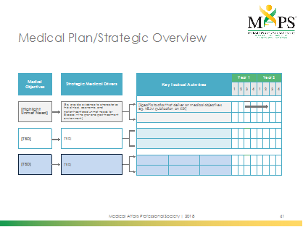
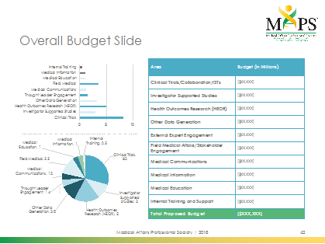
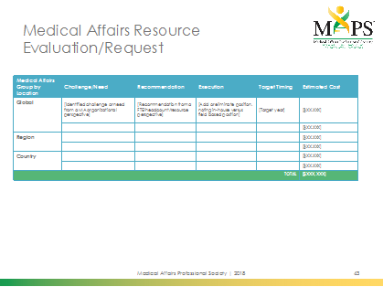
Medical Plan Summary
Helps the MA team to:
  Guide appropriate personnel and financial resourcing
  Inform operational and budgetary decision-making throughout the year
Provides top-line view of the medical plan
  Can be used for management and other cross-functional internal stakeholder presentations and discussions
Medical Summary

Slide 50
Next Steps: Executing and Monitoring Your Medical Plans
Consider…
  Electronic tools for management of the medical affairs plan across all functional groups
    Should tie together overall strategy, tactical execution, and metrics
    Owned by MA functional team members
    Could be managed by agency partners (if needed)
    Define key metrics that will demonstrate progress
  Regular check-ins with medical affairs functional teams to monitor progress on tactical execution and re-evaluate strategy/tactics based on changes in the market
  Key reports to provide status and updates to the
  cross-functional internal teams to demonstrate the value
  of the medical affairs team
Next Steps

Slide 51
Medical Affairs Strategic Plan (Template)
[Product, Indication, or Disease State]
[Year]

Slide 52
Please Note:
This template has been developed with senior medical affairs professionals to provide guidance to components that comprise the strategic medical affairs planning for a product – including the situational analysis, medical strategy, and tactical/operational planning.
The template slides do not need to be used in totality or in the order suggested, as requirements by company may vary.
The template simply provides a foundation for consideration during your annual planning cycle
Please refer to the MAPS Medical Affairs Strategic Planning Guide created in concert with this template for detailed guidance and recommendations

Slide 53
Medical Affairs Strategic Plan Template Key Sections
Slide 54 – Situational Analysis
Understanding your product in the context of the therapeutic space
Components of this section: The Disease, Therapeutic Landscape, our Product – Profile and Data, Stakeholder Insights, and Gap Analysis
Slide 70 – Medical Strategy
Defining the medical strategies that enable the strategic vision for the product to be realized
Components of this section: Vision, Medical Objectives, and Strategic Medical Drivers
Slide 75 – Tactical and Operational Plan
Operationalizing the key initiatives that deliver the medical strategy by medical affairs functional group
Components of this section: Medical Affairs Functional Activities
Slide 88 – Medical Plan Summary
Summarizing the resources required to effectively execute the medical plan
Components of this section: Medical Plan Strategic Overview, Budgets, Timelines, and Resources

Slide 54
Situational Analysis
The Disease
Therapeutic Landscape
Product Profile
Stakeholder Insights
Gap Analysis

Slide 55
Disease and Treatment Summary
Etiology | [Key insight]
Prevalence/incidence | [Key insight]
Symptoms | [Key insight]
Diagnosis | [Key insight]
Patient, including sub-populations | [Key insight]
Treating specialists | [Key insight]
Current treatments (classes, options) | [Key insight]
Other | [Key insight]

Slide 56
Patient Clinical and Treatment Flow
(Tree Diagram)
Key Points
[Highlights per therapeutic area or product]
[Highlights per therapeutic area or product]
[Highlights per therapeutic area or product]
[Highlights per therapeutic area or product]
Prevalence/Incidence
[Description
and Number]
Burden of Disease
[Description
and Number]
Diagnosis
[Description
and Number]
Treatment Choice
[Description
and Number]
[Description
and Number]
Class/Product Choice
[Description
and Number]
[Description
and Number]
[Description
and Number]
[Description
and Number]
[Description
and Number]
Adherence/Outcomes of Interest
[Description
and Number]
[Description
and Number]
[Description
and Number]
[Description
and Number]

Slide 57
Typical Patient Journey
Patient Characteristics
[X]
[X]
Patient
Characteristics
Monitoring
and Follow-up
2018
2018
2018
2018
Diagnosis
Treatment
[TBD]
[TBD]
[TBD]
[TBD]
[TBD]
[TBD]
[TBD]
[TBD]
[TBD]
[TBD]
[TBD]
[TBD]
[TBD]
[TBD]
[TBD]
[TBD]
Diagnosis
Treatment
Monitoring and Follow-up
HCPs Involved:
[TBD]
HCPs Involved:
[TBD]
HCPs Involved:
[TBD]

Slide 58
Key External Stakeholder Insights*
External Stakeholder | Insight | Implications
[External expert] [Summary] | [Describe major insights relative to stakeholder perception of value] | [Describe the implications relative to informing medical strategy]
[Healthcare professional] [Summary]
[Payers/HTA] [Summary]
[Patients] [Summary]
Other (eg, advocacy groups, caregivers, etc.) [Summary]
*All sources (Advisory boards, literature, Field Medical engagement, and others)

Slide 59
Key External Stakeholders:
Needs
[Stakeholder]
[Stakeholder]
[Stakeholder]
[Stakeholder]
Summary
Summary
Summary
Summary
[Met and unmet needs]
[Met and unmet needs]
[Met and unmet needs]
[Met and unmet needs]

Slide 60
Key External Stakeholders:
Educational Gaps
[Stakeholder]
[Stakeholder]
[Stakeholder]
[Stakeholder]
[Educational gap]
[Educational gap]
[Educational gap]
[Educational gap]

Slide 61

Key Congresses and
Scientific Meetings
Congress | Date | Location | Region | Target Audience | Size
 | [Date range] | [City, state, country] | [Global, EU, Asia Pacific, etc.] | [Aligned to key audiences] | [Estimated number of attendees]

Slide 62


Reimbursement Landscape
Country | Product | Approved Indication(s) | Criteria for Reimbursement
[Name], [Flag icon] | [Product, generic name] | ✓ [Indication] | [Key points to note]
[Name], [Flag icon]

Slide 63
Competitive Landscape:
Overview
Item | Your Product | Competitor A | Competitor B | Competitor C
Company | [TBD] | [TBD] | [TBD] | [TBD]
Company therapeutic expertise
Phase of development
Key clinical trials (ongoing)
Launch dates (completed and anticipated)
Key scientific differentiators
Strengths
Weakness
Regions available
Cost

Slide 64
Competitive Landscape:
Label Comparison
Characteristic | Your Product | Medical/ Scientific Advantage* | Competitor A | Competitor B | Competitor C
Indication/status | [TBD] | [TBD; +,-,=] | [TBD] | [TBD] | [TBD]
Dosage and administration
Efficacy
Side effects/tolerability
Safety/contraindicated population
Pharmacokinetics
Mechanism of action
*+ Indicates medical or scientific advantage for product; = indicates product equivalence; - indicates product disadvantage

Slide 65
Target Product Profile (if Pre-Launch)
Indication | Efficacy | Safety and Tolerability | Dosing/ Administration | Outcomes
[Patient type] [Line of therapy] [Diagnostic requirement] | [Approvable endpoints] | [TBD] | [TBD] | [TBD]
 | [TBD] | [TBD] | [TBD] | [TBD]
 | [TBD] | [TBD] | [TBD] | [TBD]
Optimistic
Target
Minimal

Slide 66
Key Events, Development and Lifecycle Activities
Legend
Congress
Dates Locations
US
Congress
Dates Locations
Congress
Dates Locations
Europe
Congress Activities
Asia Pacific
EXTERNAL
Major Congress
TBD Approval
Key Data Release
Key Competitor
Competition
Key Competitor
Q1 2018
Q2
2018
Q3 2018
Q4 2018
Q1 2019
Q2
2019
Q3 2019
Q4 2019
Key Events
Updated Label: AE Events
Key Event
APPROVAL (Drug X)
INTERNAL
Trial Initiation
Data Readout (Expected)
Regulatory Submission
Phase 3 Trial Name
Details:
Development Activities

Slide 67
Situational Analysis Summary:
Unmet Needs/Challenges
Area of Need | Current Unmet Need or Challenges
Disease management | [TBD]
HCP treatment preference and options | [TBD]
Tolerability | [TBD]
Adherence | [TBD]
Effectiveness | [TBD]
Safety | [TBD]
Other | [TBD]

Slide 68
Situational Analysis Summary:
Gap Identification
Unmet needs | Remaining Gaps
1 [Unmet need] | [Generation, interpretation, communication and/or educational gap]
2 [Unmet need] | [Generation, interpretation, communication and/or educational gap]
3 [Unmet need] | [Generation, interpretation, communication and/or educational gap]
4 [Unmet need] | [Generation, interpretation, communication and/or educational gap]
5 [Unmet need] | [Generation, interpretation, communication and/or educational gap]
6 [Unmet need] | [Generation, interpretation, communication and/or educational gap]
7 [Unmet need] | [Generation, interpretation, communication and/or educational gap]

Slide 69
Situational Analysis Summary:
Medical SWOT
[TBD] | [TBD]
[TBD] | [TBD]
S
W
O
T

Slide 70
Medical Strategy
Vision
Medical Objectives
Strategic Medical Drivers

Slide 71
Medical Objective 1
Medical Objective
1.
Strategic Medical Drivers
A.
B.
C.
D.

Slide 72
Medical Objective 2
Medical Objective
2.
Strategic Medical Drivers
A.
B.
C.
D.

Slide 73
Medical Objective 3
Medical Objective
3.
Strategic Medical Drivers
A.
B.
C.
D.

Slide 74
Strategic Summary
VISION
[Vision]
Medical Objectives
1.
2.
3.
Strategic Medical Drivers
A.
B.
C.
D.
A.
B.
C.
D.
A.
B.
C.
D.
Key Metrics
[Key metrics]
[Key metrics]
[Key metrics]

Slide 75
Tactical and Operational Plan
Medical Affairs Functional Activities

Slide 76
Medical Affairs Functions:
Tactical and Operational Planning
Medical Affairs Functions*
Slide
77
Clinical Trials/ Collaborations
Slides 82
Field Medical/External Stakeholder Engagement
Slide 78
Investigator Supported Studies
Slide 83
Key Scientific Themes and Communication Objectives
Slide
79
Health Outcomes Research (HEOR)
Slide
84
Key Medical Communications
Slide 80
Other Data Generation
Slide 85-86
Medical Information/Education
Slide 81
External Expert Engagement
(ie, Advisory boards, Scientific Advice)
Slide 87
Internal Training
and Support
*Functions may vary by organization

Slide 77
Clinical Trials and Collaborations
Activities
 | Project Description | Driver | Output | Target Audience | Budget | Owner | Year 1 |  |  |  | Year 2
 |  |  |  |  |  |  | 1 | 2 | 3 | 4 | 1 | 2 | 3 | 4
Clinical Trials/Collaborations | [Describe the activity that will be conducted] |  | [Publication, label change, etc.]
◆
◆
•
◆ Projected Submission
• Projected Completion

Slide 78
Investigator Supported Studies
 | Areas of Interest | Areas out of Scope
1 | [TBD] | [TBD]
2
3
4
5
6
7
DISCLAIMER: FOR INTERNAL USE AND GOVERNANCE ONLY: Please discuss with legal/compliance representatives to ensure this is appropriate

Slide 79
Health Outcomes Research
Activities
 | Project Description | Driver | Output | Target Audience | Budget | Owner | Year 1 |  |  |  | Year 2
 |  |  |  |  |  |  | 1 | 2 | 3 | 4 | 1 | 2 | 3 | 4
Research/Collaborations | [Describe the activity that will be conducted] |  | [Publication, label change, etc.]
◆
•
◆ Projected Submission
• Projected Completion

Slide 80
Other Data Generation
Activities
 | Project Description | Driver | Output | Target Audience | Budget | Owner | Year 1 |  |  |  | Year 2
 |  |  |  |  |  |  | 1 | 2 | 3 | 4 | 1 | 2 | 3 | 4
Research/Collaborations | [Describe the activity that will be conducted] |  | [Publication, label change, etc.]
◆
•
◆ Projected Submission
• Projected Completion

Slide 81
External Expert Engagement
Activities
 | Stakeholder Segment | Project Description | Driver | Output | Budget | Owner | Year 1 |  |  |  | Year 2
 |  |  |  |  |  |  | 1 | 2 | 3 | 4 | 1 | 2 | 3 | 4
External Expert Engagement | [Expert or other stakeholder] | Describe the activity that will be conducted |  | External insights into clinical trial, etc.
◆
•
◆ Projected Submission
• Projected Completion

Slide 82
Field Medical Affairs/Stakeholder Engagements
Activities
 | Stakeholder Focus | Rationale | Driver | Deliverables/Outputs | Budget | Owner | Year 1 |  |  |  | Year 2
 |  |  |  |  |  |  | 1 | 2 | 3 | 4 | 1 | 2 | 3 | 4
Field Medical Affairs/Stakeholder Engagement | [HCP or other stakeholder] | [Describe the rationale behind engagement] |  | [Slide deck, focused engagement, etc.]
◆
•
◆ Projected Submission
• Projected Completion

Slide 83
Key Scientific Themes and Communication Objectives
Scientific Themes
Communication Objectives
[Theme, eg, Unmet Need]
[Insert specific scientific communications points developed by the publications team that address the overall scientific themes]
[Theme]
[Insert specific scientific communications points developed by the publications team that address the overall scientific themes]
[Theme]
[Insert specific scientific communications points developed by the publications team that address the overall scientific themes]
[Theme]
[Insert specific scientific communications points developed by the publications team that address the overall scientific themes]
DISCLAIMER: FOR INTERNAL USE AND GOVERNANCE ONLY: Please discuss with legal/compliance representatives to ensure this is appropriate

Slide 84
Key Medical Communications
Activities
 | Project Description | Driver | Output | Target Audience | Budget | Owner | Year 1 |  |  |  | Year 2
 |  |  |  |  |  |  | 1 | 2 | 3 | 4 | 1 | 2 | 3 | 4
Medical Communications | [Describe the activity that will be conducted] |  | [Publication, core value dossier, slide deck, etc.]
◆
•
◆ Projected Submission
• Projected Completion

Slide 85
Medical Information
Activities
 | Project Description | Anticipated Focus or Questions | Driver | Output | Target Audience | Budget | Owner | Year 1 |  |  |  | Year 2
 |  |  |  |  |  |  |  | 1 | 2 | 3 | 4 | 1 | 2 | 3 | 4
Medical Information | [Describe the activity that will be conducted] | [Determine key areas of focus or questions to be answered] |  | [Letter, slide deck, etc.]
◆
•
◆ Projected Submission
• Projected Completion

Slide 86
Medical Education
Activities
 | Project Description | Driver | Output | Target Audience | Budget | Owner | Year 1 |  |  |  | Year 2
 |  |  |  |  |  |  | 1 | 2 | 3 | 4 | 1 | 2 | 3 | 4
Medical Education | [Describe the project that will be communicated] |  | [Slide deck, symposium, etc.]
◆
•
◆ Projected Submission
• Projected Completion

Slide 87
Internal Training and Support
Activities
 | Project Description | Driver | Output | Target Audience | Budget | Owner | Year 1 |  |  |  | Year 2
 |  |  |  |  |  |  | 1 | 2 | 3 | 4 | 1 | 2 | 3 | 4
Internal Training and Support | [Describe the activity that will be conducted] |  | [Dossier, slide deck, etc.]
◆
•
◆ Projected Submission
• Projected Completion

Slide 88
Medical Plan Summary
Medical Plan Strategic Overview
Budgets
Timelines
Resources

Slide 89
Medical Plan/Strategic Overview
Medical
Objectives
Strategic Medical Drivers
Key Tactical Activities |  |  | Year 1 |  |  |  | Year 2
 |  |  | 1 | 2 | 3 | 4 | 1 | 2 | 3 | 4
[Specific tactics that deliver on medical objectives, eg, NEJM publication on TBD]
[Highlight Unmet Need]
[Eg, provide evidence to characterize the clinical, economic, and
patient-centered unmet needs for disease in the pre- and post-treatment environment]
[TBD]
[TBD]
[TBD]
[TBD]

Slide 90
Overall Budget Slide
Area | Budget (in Millions)
Clinical Trials/Collaboration/ISTs | [$XX,XXX]
Investigator Supported Studies | [$XX,XXX]
Health Outcomes Research (HEOR) | [$XX,XXX]
Other Data Generation | [$XX,XXX]
External Expert Engagement | [$XX,XXX]
Field Medical Affairs/Stakeholder Engagement | [$XX,XXX]
Medical Communications | [$XX,XXX]
Medical Information | [$XX,XXX]
Medical Education | [$XX,XXX]
Internal Training and Support | [$XX,XXX]
Total Proposed Budget | [$XXX,XXX]

Slide 91
Medical Affairs Resource Evaluation/Request
Medical Affairs Group by Location | Challenge/Need | Recommendation | Execution | Target Timing | Estimated Cost
Global | [Identified challenge or need from a MA organizational perspective] | [Recommendation from a FTE/headcount/resource perspective] | [Add or eliminate position, noting in-house versus field based position] | [Target year] | [$XX,XXX]
Region
Country
TOTAL |  |  |  |  | [$XXX,XXX]

Slide 92
Acknowledgments
The Medical Affairs Professional Society (MAPS) would like to thank the following contributors to the MAPS Medical Affairs Strategic Planning Guide and Template:
    Charlotte Kremer, MD, MBA, EVP, and Head of Medical Affairs,
    Astellas Pharma, Northbrook, IL
    Joseph Kohles, PhD, Chief Medical Officer, Envision Pharma Group, Philadelphia, PA
    Peter Piliero, MD, VP, US Medical Affairs, Merck & Co. Upper Gwynedd, PA
    Therese McCall, PhD, MBA, Vice President, Medical Affairs, Assertio Therapeutics, Lake Forest, IL
    Leah Williams, MS, Medical Strategy Lead, Envision Pharma Group, Philadelphia, PA
Those named above contributed to MAPS Medical Affairs Strategic Planning Guide and Template in their personal capacity. The views expressed and guidance provided in the guide and template are their own and do not necessarily represent the views of their named employers.

